Slide 1

National University of Computer and Emerging Sciences,
Islamabad, Pakistan
Introduction to Artificial Neural Networks
DS-5006: Deep Learning
Dr. Noshina Tariq
Department of Computer Science

Slide 2
Goals
Today’s Lecture
Biological Neural Networks
Artificial Neural Networks?
Rosenblatt's Neural Network
Performance Evaluation of ML models

Slide 3
Brain and Machine
The Brain
Pattern Recognition
Association
Complexity
Noise Tolerance
The Machine
Calculation
Precision
Logic

Slide 4
The contrast in architecture
The Von Neumann architecture uses a single processing unit;
Tens of millions of operations per second
Absolute arithmetic precision
The brain uses many relatively slow processors acting in parallel

Slide 5

Features of the Brain
Ten billion (10¹⁰) neurons
On average, several thousand connections
Hundreds of operations per second
Compensates for problems by massive parallelism

Slide 6
The biological inspiration
The brain has been extensively studied by scientists.
Vast complexity prevents all but rudimentary understanding.
Even the behaviour of an individual neuron is extremely complex

Slide 7
The biological inspiration
Single “percepts” distributed among many neurons
Localized parts of the brain are responsible for certain well-defined functions (e.g. vision, motion).

Slide 8
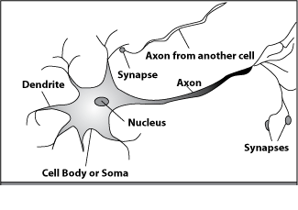
How do our brains work?
A processing element
Dendrites: Input
Cell body: Processor
Synaptic: Link
Axon: Output

Slide 9
How do our brains work?
A processing element
A neuron is connected to other neurons through synapses

Slide 10
The Structure of Neurons
A neuron has a cell body, a branching input
structure (the dendrIte) and a branching output structure (the axOn)
Axons connect to dendrites via synapses.
Electro-chemical signals are propagated from the dendritic input, through the cell body, and down the axon to other neurons

Slide 11
The Structure of Neurons
A neuron only fires if its input signal exceeds a certain amount (the threshold) in a short time period.
Synapses vary in strength
Good connections allowing a large signal
Slight connections allow only a weak signal.

Slide 12
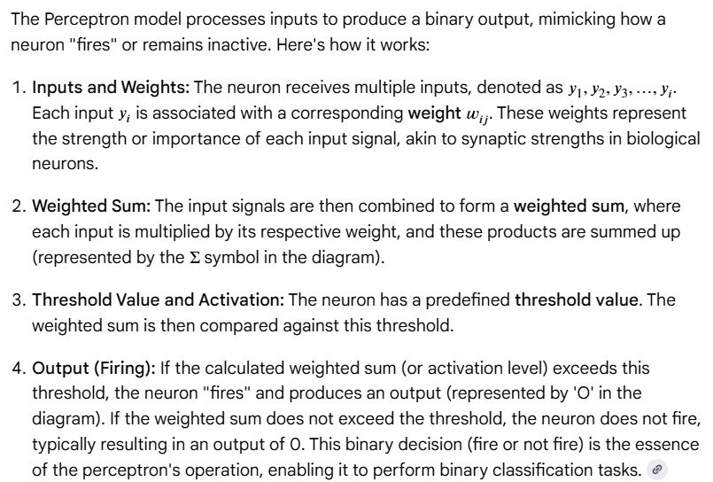
A Simple Model of a Neuron(Perceptron)
y₁
w_{1j}
y₂
w_{2j}
w_{3j}
O
y₃
y_{i}
w_{ij}
Each neuron has a threshold value
Each neuron has weighted inputs from other neurons
The input signals form a weighted sum
If the activation level exceeds the threshold, the neuron “fires”

Slide 13
An Artificial Neuron
y₁
w_{1j}
y₂
w_{2j}
w_{3j}
f(x)
O
y₃
y_{i}
w_{ij}
Each neuron has weighted input connections from each of the units in the preceding layer.
The unit performs a weighted sum of its inputs, to give its activation level.
Activation level is passed through a sigmoid activation function to determine output.

Slide 14
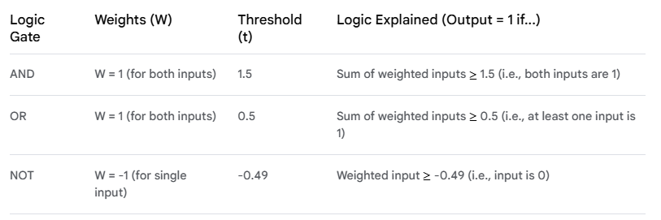
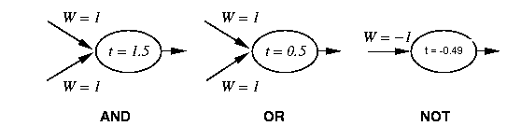
Perceptron Training
1 if Σ w_{i} x_{i} >t
Output =
0 otherwise
{
_{i=0}
Linear threshold is used.
W - weight value
t - threshold value

Slide 15
Artificial Neural Networks
The “building blocks” of neural networks are the neurons.
In technical systems, we also refer to them as units or nodes.
Basically, each neuron
receives input from many other neurons.
changes its internal state (activation) based on the current input.
sends one output signal to many other neurons, possibly including its input neurons (recurrent network).

Slide 16
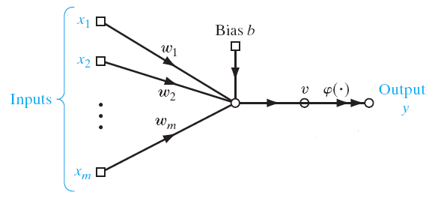
Rosenblatt's perceptron model
Rosenblatt's original perceptron model contained only one layer.
From this, a multi-layered model was derived in 1960.
The input is summed after multiplying with weights and the output is produced with as positive or negative.

Slide 17
Rosenblatt's perceptron model
At first, the use of the multi-layer perceptron (MLP) was complicated by the lack of an appropriate learning algorithm.
In 1974, Werbos came to introduce a so-called backpropagation algorithm for the three-layered perceptron network.

Slide 18
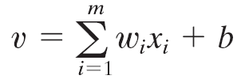
Rosenblatt's perceptron model
The synaptic weights of the perceptron are denoted by w1,w2, ...,w_{m}.
The inputs applied to the perceptron are denoted by x1, x2, ..., x_{m}.
The externally applied bias is denoted by b.
The output can be calculated by:

Slide 19
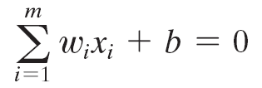
Rosenblatt's perceptron model
In the simplest form of the perceptron, there are two decision regions separated by a hyperplane, which is defined by

Slide 20
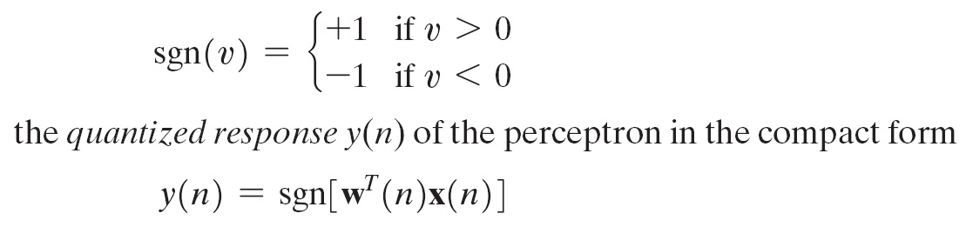
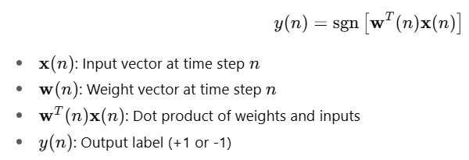
Rosenblatt's perceptron model
Sign Function
Common in perceptrons using hard thresholding (instead of sigmoid).
The sgn function (signum) is used to produce a binary classification.

Slide 21
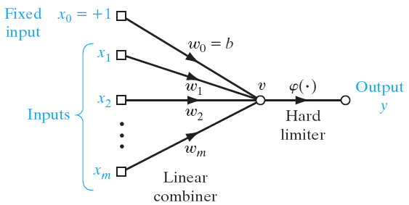
Rosenblatt's perceptron model

Slide 22
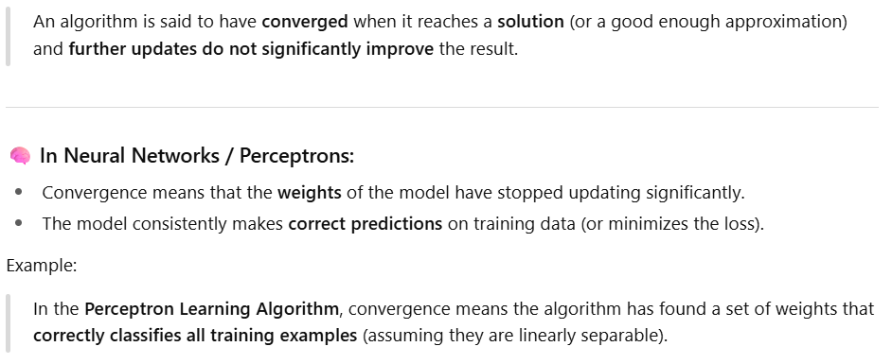

Slide 23
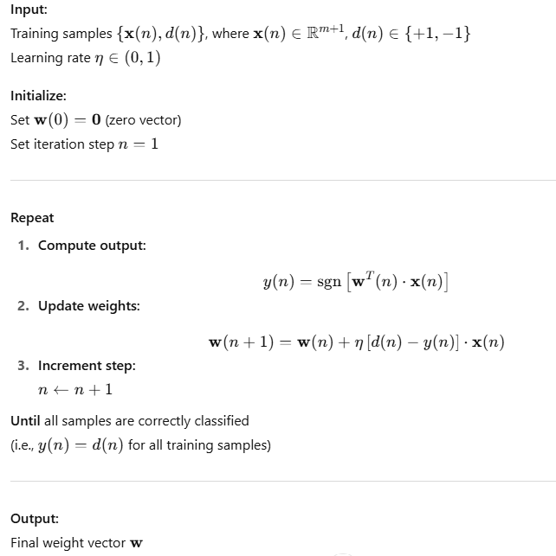
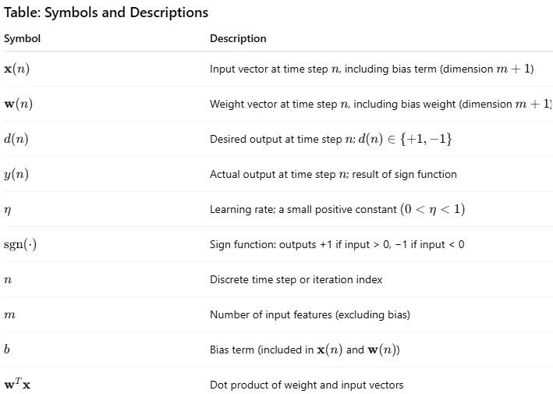
Perceptron Learning

Slide 24

Rosenblatt's perceptron model
Need to find a weight vector w such that :

Slide 25
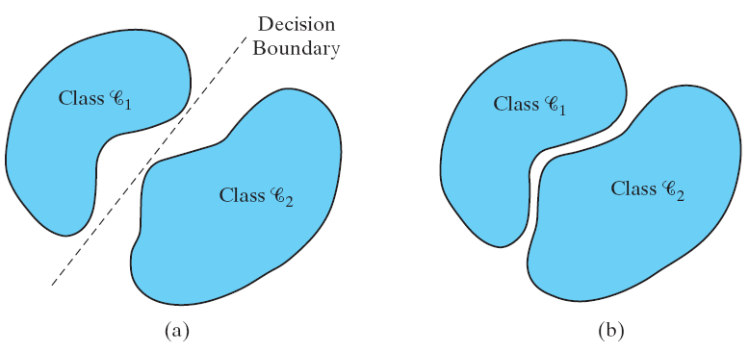
Rosenblatt's perceptron model

Slide 26
Rosenblatt's perceptron model
No need to update weights if correctly predicted:
The weight is updated for incorrect predictions as:

Slide 27
Rosenblatt's perceptron model
learning-rate parameter η(n) controls the adjustment applied to the weight vector at iteration n.
Usually the value of is set to η>0
It can be set to a fixed value
It can also be adaptively updated for each iteration.

Slide 28
Rosenblatt's perceptron model
Rosenblatt’s perceptron, which is basically a single-layer neural network
Network is limited to the classification of linearly separable patterns.
What if a more complex and deeper network architecture is introduced?

Slide 29
Decision boundaries
In simple cases, divide feature space by drawing a hyperplane across it.
Known as a decision boundary.
Discriminant function: returns different values on opposite sides. (straight line)
Problems which can be thus classified are linearly separable.

Slide 30
Linear Separability
X₁
A
A
A
Decision
Boundary
B
A
A
B
B
B
A
B
A
B
B
X₂
B

Slide 31
Rugby players & Ballet dancers
Rugby ?
2
Height (m)
Ballet?
1
50
120
Weight (Kg)

Slide 32
Hyperplane partitions
A single Perceptron (i.e. output unit) with connections from each input can perform, and learn, a linear separation.
Perceptrons have a step function activation.

Slide 33
Learning algorithm
Epoch : Presentation of the entire training set to the neural network. In the case of the AND function an epoch consists of four sets of inputs being presented to the network (i.e. [0,0], [0,1], [1,0], [1,1])
Error: The error value is the amount by which the value output by the network differs from the target value. For example, if we required the network to output 0 and it output a 1, then Error = -1

Slide 34
Learning algorithm
Target Value, T : When we are training a network we not only present it with the input but also with a value that we require the network to produce. For example, if we present the network with [1,1] for the AND function the target value will be 1
Output , O : The output value from the neuron
Ij : Inputs being presented to the neuron
Wj : Weight from input neuron (I_{j}) to the output neuron
LR : The learning rate. This dictates how quickly the network converges. It is set by a matter of experimentation. It is typically 0.1

Slide 35
Training Perceptrons
For AND
X Y Output
0 0 0
0 1 0
1 0 0
1 1 1
-1
W₁ = ?
x
t = 0.0
W₂ = ?
W₃ = ?
y
What are the weight values?
Initialize with random weight values

Slide 36
Training Perceptrons
For AND
A B Output
0 0 0
0 1 0
1 0 0
1 1 1
-1
W₁ = 0.3
x
t = 0.0
W₂ = 0.5
W₃ =-0.4
y

Slide 37
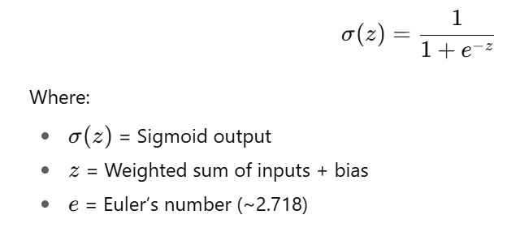
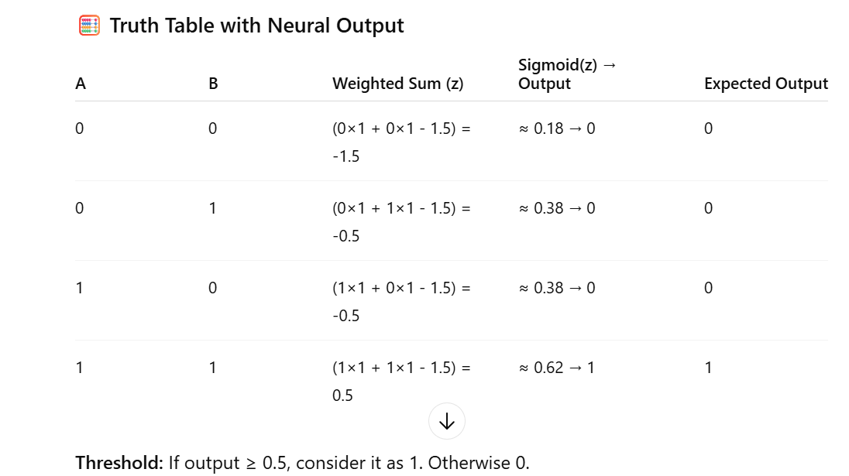

AND Gate

Slide 38
Learning in Neural Networks
Learn values of weights from I/O pairs
Start with random weights
Load training example’s input
Observe computed input
Modify weights to reduce difference
Iterate over all training examples
Terminate when weights stop changing OR when error is very small

Slide 39
References
Chapter 1, Neural Networks and Learning Machines, Simon Haykin
Chapter 5, Deep learning book

Slide 40
Thank You ☺

